Slide 2
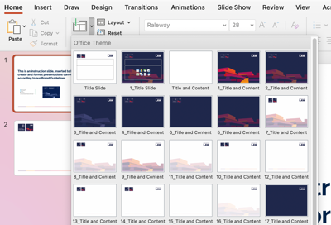
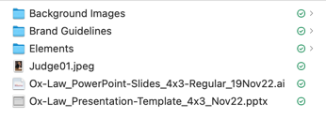
This is an instruction slide, inserted to help you create and format presentations correctly according to our Brand Guidelines.
1. Download and install the necessary elements, image assets and fonts.
2. Familiarise yourself with our Brand Guidelines.
3. Make use of the template slides embedded in this PP’ document (New Slide).
4. Remember to delete or move this slide before presenting!

Slide 3
Titles should be in Raleway Bold font
Paragraphs and bullet points in Minion Pro. The Semi Bold weight is easily read from distance.
Use quality images that are clear, label and credit them.
Good luck!
Photo: Giammarco, Unsplash.

