Slide 1
What makes people trust an ombudsman ? A French case study
Le mediateur national de l’energie

Slide 2
the French energy ombudsman
Created by the law regarding the energy sector dated December 2006
A public institution, completely independent from the energy companies
Financed through public fund (5,8 millions euros in 2015)
The Ombudsman is appointed by the government for 6 years. His mandate is irrevocable and non renewable
2 legal missions :
To recommend solutions to disputes between energy companies, and small/medium-sized companies or domestic consumers
To provide information to the energy consumers about their rights

Slide 3

the French energy ombudsman
Our skills :
Electricity and natural gas consumption (2006 law)
All energies consumed since the law regarding the energy transition dated August 2015 (fuel, liquid petroleum gas, wood-fired heating, network heating…)
Our activity regarding disputes resolution in the energy sector since 2008
More than 100 000 disputes handled in the energy sector
More than 12 000 written recommendations
More than 75% of our recommendations are followed by energy companies
ADR fully compliant with the ADR directive
Notified by the French government to the European Commission in January 2016

Slide 4
Our contribution to the ESRC project
Study carried by Dr. Creutzfeld to get a better understanding of the existence of ADR bodies
Survey administrated between December 2014 and July 2015 to 1800 consumers / 243 answers
Main results : a high level of satisfaction
87% declared they trusted us
91% were satisfied with the ombudsman
74% found the results of the mediation fair and impartial
97,5% would recommend our services
Key factors : speed of execution, independence, transparency, neutrality

Slide 5
Our way of handling disputes in the French energy sector
Simple and user-friendly access, to limit abandon
First contact possible by phone on a toll free number
Online appeal (ODR)
Free of charge mail box
Current legislation and regulation are taken into account
Several personalized contacts to explain our analyses avoiding technical explanations
Consumers are always informed at the end of the process of the jurisdiction recourses they have if they are not satisfied or if our recommendation is not followed

Slide 6
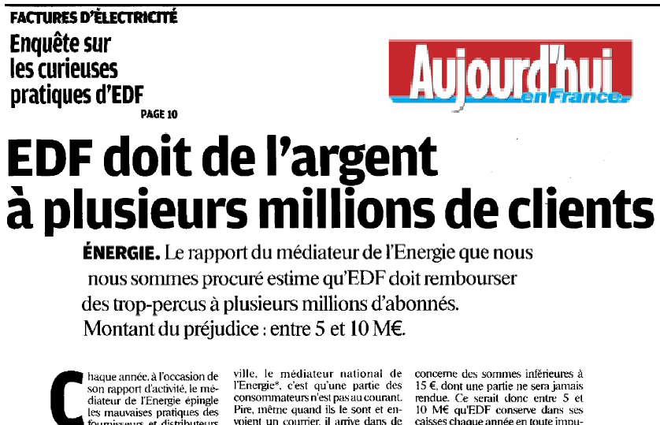


From individual decisions to law proposals
The national energy ombudsman discovers bad practices of the market operators
We give a generic range to some of our recommendations
400 generic recommendations are published online, anonymously
In case of repeated bad practices : naming & shaming of the operator
The national energy ombudsman suggests new laws to public authorities to improve consumer protection
+400
recommendations published online

Slide 7
Some LEGAL measures recommended by the ombudsman
The Law of April 15th 2013 set up a winter truce during which operators are forbidden to cut off supplies to consumers
The Law of August 17th 2015 related to the energy transition includes several measures recommended by the ombudsman :
An energy cheque will replace the electricity and natural gas social tariffs to pay any domestic energy bill (not only electricity and gas)
A one year limit to any back billing on energy consumption has been adopted when the suppliers or the DSO are at fault in not billing a domestic customer regularly

