Slide 1
X2C Internet of Things – an international challenge
Claire Milne
c.milne@lse.ac.uk
cbm@antelope.org.uk
OBOR Conference, Digital Economy session
Oxford, 14 September 2017

Slide 2
Background to my remarks
Me: freelance telecom policy consultant, ex-BT; also LSE VSF, active in consumer and policy circles (CFC, CSISAC, FISP).
B2C IoT hit me via OECD, from 2014; identified key issues needing more attention, spoke at 2016 OECD Ministerial on Digital Economy.
Started virtual group of interested consumer representatives and policy-oriented academics, exchanging news and views. We feel that:
Countries and companies, anxious to get in on the action, stress the benefits and often overlook the problems.
To approach key issues, we need strong consumer/citizen representation in many areas of IoT development – policies, standards, guidelines, design, and instructions. Despite acceptance that the market is not enough, wider participation is often un- or under-funded.
My remarks owe much to colleagues but are a personal view.

Slide 3
Which aspects of IoT concern us?
By X2C we mean IoT with a direct consumer or citizen interface, such as:
B2C e.g. wearables, smart homes, retail, automobile
G2C e.g. healthcare, smart cities, energy efficiency
Environmental monitoring, agriculture, industrial internet etc also affect consumers and citizens, but less directly.
A fundamental issue is unawareness. X2C IoT operations often include:
receiving and/or sending data related to individual consumers
without the active involvement of the individual in question,
together with the communications, processing and applications of this data.

Slide 4
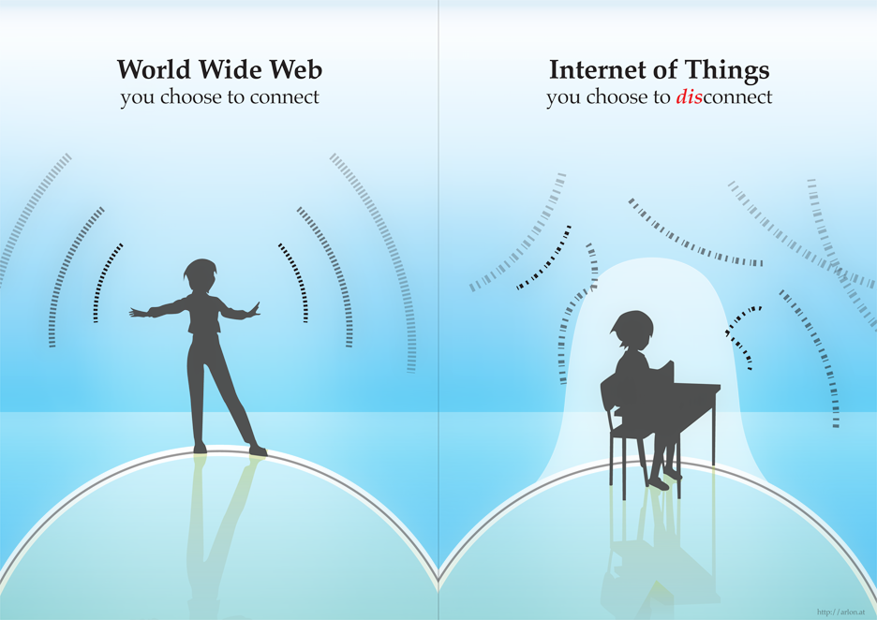
Unawareness is of the essence of IoT…
Source: http://arlon.at/iot/
Where is IoT going? Somewhere that you won’t see "Successful IoT projects... become essentially invisible," according to IDC associate vice-president for IoT Asia Pacific, Hugh Ujhazy. "If they're really working well, you never really see them.“
Source: CommsWire 3 March 2017

Slide 5
Some potential consumer problems
From consumer research, people don’t buy because of:
Lack of awareness of B2C IoT products or their benefits.
Insufficient perceived value.
User-unfriendliness – hard to set up or run.
Lack of confidence in security or correct working.
Risks to privacy.
From experts, barriers to adoption and problems include:
Risks to privacy, often via poor security (need Privacy By Design – ideas exist but implementation at early stage).
Inadequate pre-purchase information and post-purchase rights – these are experience products.
Accessibility for disabled people and potential exclusion of non-users.
Interoperability and updatability of devices.
Complex value chain – making it hard to pin down responsibility for problems and for consumers to get redress (cf product liability issues).
Serious malfunction (danger to individuals or groups).
Product ownership versus rental – alternatives to subscription model?
See Consumers International report Connection and Protection in the Digital Age

Slide 6
Some key issues affecting policy
The awareness dilemma – people want routine operations to be automated, yet still in accordance with their wishes.
How much choice? – people need to retain autonomy but not be overwhelmed by options. Defaults will play a vital role.
Who has control? – consumers (and which consumers?), their machines, or the firms behind the machines?
How do people know that vendor claims are true? – “Lifting the bonnet” will mean little to most of us.
Social and private interests may well diverge – my freedom to drive unsurveilled puts you at risk of a traffic accident.
How can we bring individuals’ preferences to bear on such issues?
How can we resolve tensions like #5 in the overall public interest?

Slide 7
What has been done: some UK examples
Consumer Focus (now Citizens Advice) worked closely with government on the smart metering framework – building in respect for individual choice and privacy.
BSI’s Consumer and Public Interest Network, input to standards for consumer-focused Privacy by Design (Pete Eisenegger).
NESTA report Rethinking Smart cities from the Ground Up: what matters most is smart citizens.
Parliamentary Science and Technology Committee report Big Data Dilemma – in April 2016, government accepted recommendation for a Council for Data Science Ethics.
RAND Europe project for IoTUK with BCS: Public involvement in some local government IoT projects.
Many good examples of private user-centric design, including some PETRAShub projects.
Recent BCS/IET workshop: presentations and draft report now online; main topics emerging in discussion were personal data and privacy, trustworthiness and trust, device behaviour and liability, and market power issues

Slide 8
What has been done: some non-UK examples
USA:
2013: FTC IoT workshop (privacy focused)
2016/7: DoC/NTIA request for public comment on government role in IoT (and subsequent report); NTIA-led stakeholder working groups on IoT security
2017: Californian Bill to strengthen IoT security
13/06/2017 Congressional hearing on IoT opportunities and challenges
Australia:
2016 ACCAN report “Home, Tweet Home”: Implications of the Connected Home, Human and Habitat on Australian Consumers”
Continuing ACCAN engagement with IoT public policy
France: 10.01.2017 Assembly report with 20 policy recommendations, includes some especially relevant ones:
Revise Consumer Code to cover IoT products
Smart cities to provide open data and involve citizens
Agile regulation through ad hoc regulatory teams of experts
Combat potential new social divides by ensuring affordability and usability of connected objects, and providing necessary training to all for maintaining pubic service access, especially where e-health is concerned.
South Korea: well-established industry IoT Association and Master Plan, problems addressed “by social consensus”.

Slide 9
Summing up
IoT is a global phenomenon, and global solutions are needed (e.g. for interoperability and security) – but social norms vary, and countries are competing for leadership.
User concern about privacy and security has registered, and efforts are being made to improve both – but this is very challenging.
Little attention seems to be paid to consumer options and default settings, and less to private/social balances for these.
Different countries will want to strike different balances, but IoT products and services will cross borders.
We need to work together to understand what features can be the same everywhere, what can or should differ, and how to use public input to best effect.

