Slide 1
Landscapes of border control
Border criminologies

Slide 2
Background
It draws on years of research on immigration detention by Mary Bosworth
Two ESRC-IAA grants that investigated the conditions in immigration detention and the nature of human-rights based detention monitoring (Greece, Italy, Hungary and Turkey)
Reports (https://www.law.ox.ac.uk/sites/files/oxlaw/project_report_final_copy.pdf, https://www.law.ox.ac.uk/sites/files/oxlaw/monitoring_immigration_detention_at_the_borders_of_europe_compressed.pdf)
Briefing papers (https://www.law.ox.ac.uk/sites/files/oxlaw/hmip_briefing_paper.pdf, https://www.law.ox.ac.uk/sites/files/oxlaw/greece_briefing_paper.pdf)
The map was designed under a 2 year project funded by the Open Societies Foundation that seeks to support the role of civil society organisations in supporting detainees, in Italy and Greece
We are currently working on more briefing papers on detention centres in both countries and responses to COVID-19
In Greece we are also producing, together with the Greek Council for Refugees a leaflet to be handed to detainees around the country with information on their detention and ways to challenge their treatment and conditions.

Slide 3
Objectives
This map aims to visualise what goes on in detention centres in order to increase public access to knowledge about immigration and the treatment of immigrants in detention settings.
Forms of evidence: Research by Andriani and Francesca, videography, photography, original art, oral history, and testimonies from those directly affected
Designed to offer a platform to civil society organisations, solidarity groups and the public to communicate their experiences from detention.
We hope that in time, the material we provide will be enriched by original contributions from people in the field and those who have survived the centres

Slide 4
The map
The map shows the locations of facilities where irregular detainees may be detained in Greece and Italy but other places too.

Slide 5
The map
You can either zoom in on the country you are interested in or you can click the button ‘List’ for a full list of all the locations or ‘Show regions list’ for all the regions that have been added worldwide.

Slide 6
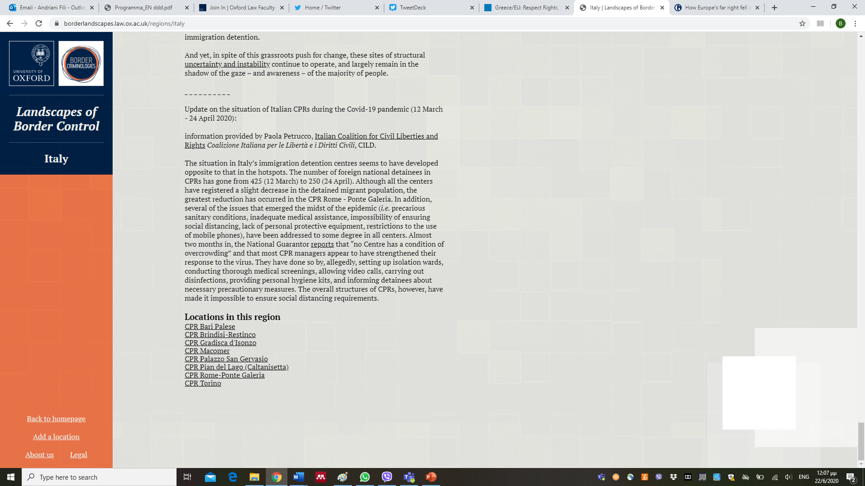
The map
By clicking on the region of interest, you can read a short overview of detention and border policies (at the moment only for Italy and Greece) and see a list of the country’s detention centres at the bottom of the page.

Slide 7
How it works
Clicking on a node, you can see the name of the centre

Slide 8
How it works
Click again and you will be directed to the centre’s page where an array of information will be provided including images, video and audio (where applicable), academic work, human rights organisations’ reports, policy briefs and other published material.

Slide 9
How you can add information
Items can be added easily through the button ‘add information to this location’ found at the bottom of each individual page.

Slide 10
How you can add information
Contributors will remain anonymous if they wish and they can add either text, document, video or audio files.

Slide 11
How you can add information

Slide 12
How you can add information
If you want to add a new site that does not exist on the map you have to click on the button ‘add a location’ on the bottom left hand side of any page

Slide 13
conclusion
This is a collaborative project, designed to give organisations and groups already in detention an avenue for publicising their findings and disseminating them to a wider audience which is not limited to their national contexts but reaches out globally.
Take the opportunity and make detention visible!
We are looking forward to hearing from you!
Share it with others!

Slide 14
Contact
Website: https://borderlandscapes.law.ox.ac.uk/
Email: bordercrim@law.ox.ac.uk, andriani.fili@crim.ox.ac.uk, Francesca.Esposito@crim.ox.ac.uk
Twitter: @BorderCrim
Facebook: @BorderCriminologies

