Slide 1
Oxford
September 10-11, 2019
Cape Town Convention Academic Project – 8th Conference
Relationship between MAC and Rail Protocols
and Domestic Secured Transactions Law
Chair: Professor Louise Gullifer, University of Oxford
Teresa Rodríguez de las Heras Ballell
Professor of Commercial Law, Universidad Carlos III de Madrid
teresa.rodriguezdelasheras@uc3m.es
Of Counsel, Andersen Tax & Legal

Slide 2
MAC and Rail Protocols
Points of interaction
Scope: covered equipment (HS / chosen Annex/ definition rail)
Transactions covered by Protocols
Limitations, gaps, and exclusions from Protocols
Referral to applicable domestic law by the Protocols (i.e. procedural laws)
Special regimes and/or special registries excluded from domestic general secured transactions law
Declarations
(opt-out)
- including ‘internal transactions’ declaration
Domestic law in Contracting States
(domestic secured transactions and related laws)

Slide 3
Overview
MAC and Rail Protocols
Points of interaction: selected themes
Scope
Registration
Immovable-associated equipment
Domestic law in Contracting States

Slide 4
1.- Scope
Not covered by listed HS codes
Not covered by rail definition
Low value equipment
A). Types of equipment
B). Limited to equipment
C). Transactions covered by Protocols

Slide 5
1.- Scope
Not covered by listed HS codes
Not covered by rail definition
Low value
A). Types of equipment
B). Limited to equipment
C). Transactions covered by Protocols
Not IP
Not all receivables
Extent of proceeds

Slide 6
1.- Scope
Not covered by listed HS codes
Not covered by rail definition
Low value
A). Types of equipment
B). Limited to equipment
Not IP
Not all receivables
Extent of proceeds
Separated accessories
Art. I.2.a/b/c. MAC equipment” means an object that falls under a Harmonized System code listed in Annex 1/2/3 to the Protocol, including all installed, incorporated or attached accessories, components and parts which do not fall within a separate Harmonized System code listed in that Annex, and all data, manuals and records relating thereto

Slide 7
1.- Scope
Not covered by listed HS codes / selected Annex/es
Not covered by rail definition
Pre-existing rights
A). Types of equipment
B). Limited to equipment
C). Transactions covered by Protocols
Not IP
Not receivables
Extent of proceeds
Separated accesories
Wider coverage by the Protocols
Special regimes in domestic laws for certain transactions
Treatment as secured transactions by domestic laws may vary (leasing laws, reservation of title) formal or functional approach

Slide 8
2.- Registration
Sanction for not registering in domestic registry
Costs and benefits of double registration
Choices of the creditor
Effects in insolvency and remedies
Debtor-based v. asset-based registries
A). Domestic and international effects of registration: double registration
B). Interconnection between domestic registries and IR
C). Notices of sale

Slide 9
2.- Registration
B). Interconnection between domestic registries and IR
Foster implementation of domestic electronic registries
Replacing or complementing
Interacting / interconnecting

Slide 10
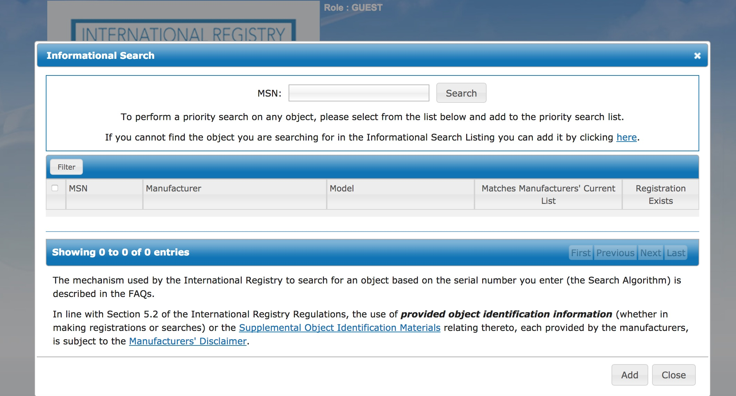
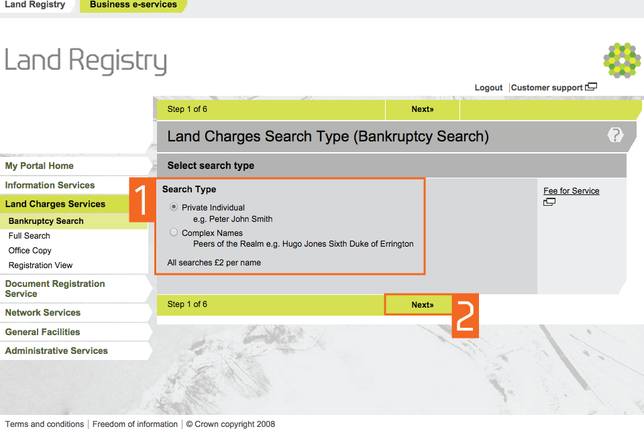
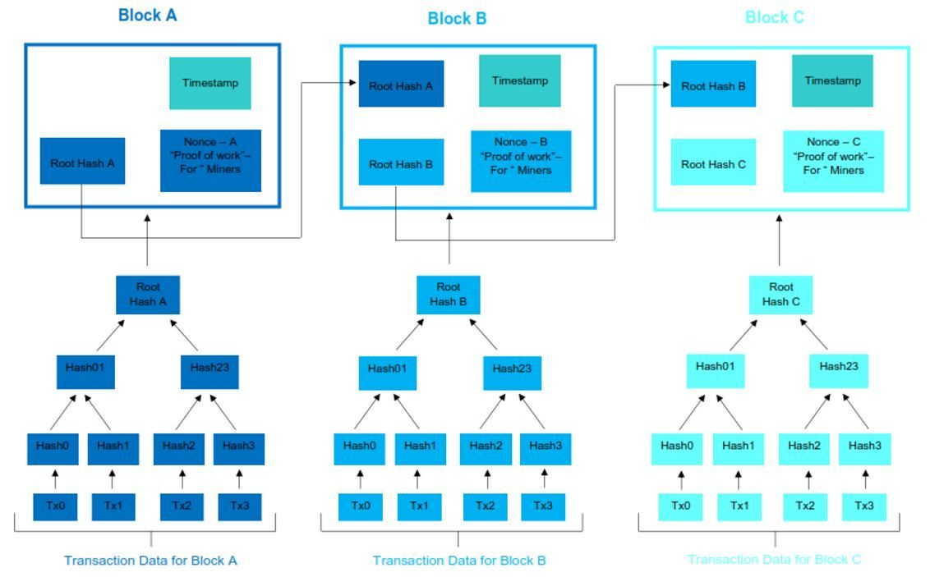
2.- Registration
Range of technological solutions and interconnection possibilities…
and CTC tenets
B). Interconnection between domestic registries and IR
Annotations in domestic registries
Interface for search and
access to data
Real-time interconnection between registries
Domestic Registrar consultation/caveat (in some jurisdictions)
Electronic platforms
Interacting / interconnecting

Slide 11
2.- Registration
Sanction for not registering in domestic registry
Costs of double registration and duplication
Effects in insolvency and remedies
A). Domestic and international effects of registration: double registration
B). Interconnection between national entry points and IR
C). Notices of sale
Any effect in domestic law?
Any effect regarding acquisition of good title by other party?
Any practical effect in domestic law?

Slide 12
Oxford
September 10-11, 2019
Relationship between MAC and rail protocols
and domestic secured transactions law
Chair: Professor Louise Gullifer, University of Oxford
Teresa Rodríguez de las Heras Ballell
Professor of Commercial Law, Universidad Carlos III de Madrid
teresa.rodriguezdelasheras@uc3m.es
Of Counsel, Andersen Tax & Legal

