Slide 1
Television Collaborations between China and the UK: From Chinese New Year to Dancing on Ice
Lisa Lin
Department of Media Arts
Royal Holloway, University of London

Slide 2
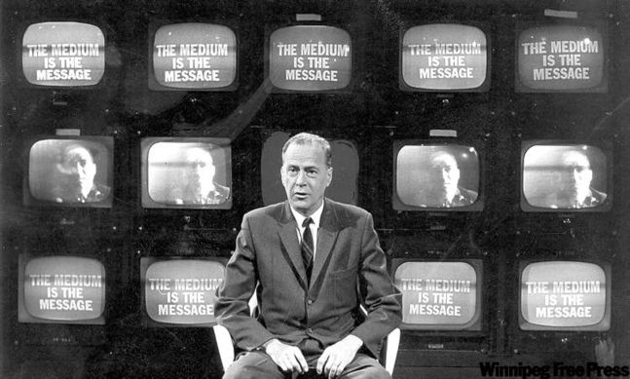
Media are means of extending and enlarging our organic sense lives into our environment.
–– Marshall McLuhan

Slide 3
A Glimpse into Chinese Media System
Three distinctive and yet inextricably intertwined sectors that jointly shape the Chinese media system and broader cultural environment.
Sector | Function
Party-state Media | Inform the nation through their domination in news and informational content provision.
Transnational Media | Groom the elite with exclusive international news, business information, lifestyle tips and niche market entertainment.
Domestic Private Media | Amuse the masses and mediate their multifaceted lived experiences with popular entertainment.

Slide 4
Five Dimensions (Appadurai)
Flows of people
Flows of technology
Flows of capital
Flows of media
Flows of ideas

Slide 5
Media Flows (Daya Thussu)
Global media flows, which are the ‘dominant flows’ of Anglo-US. (CNN, BBC, etc)
Transnational flows which have a strong regional presence but reach a global audience. (Al Jazeera, RT, etc)
Geo-cultural flows which cater to specific cultural-linguistic audiences. (Phoenix TV, etc)

Slide 6
I. UK-China Television Coproduction Treaty
£55m fund annually for the UK television industry for accessing the burgeoning Chinese market.
According to FCO, the aim is to create television programmes that combine the cultural characteristics of both countries.
This was signed at the 2016 Sino-UK High Level People to People Dialogue along with other agreements (ones with British Museum, British Library, Tate Britain and Durham University).

Slide 7
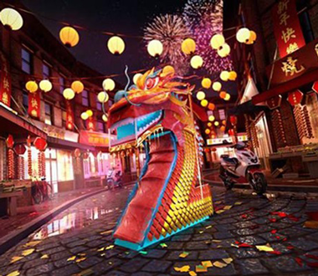
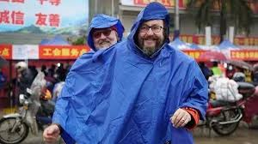
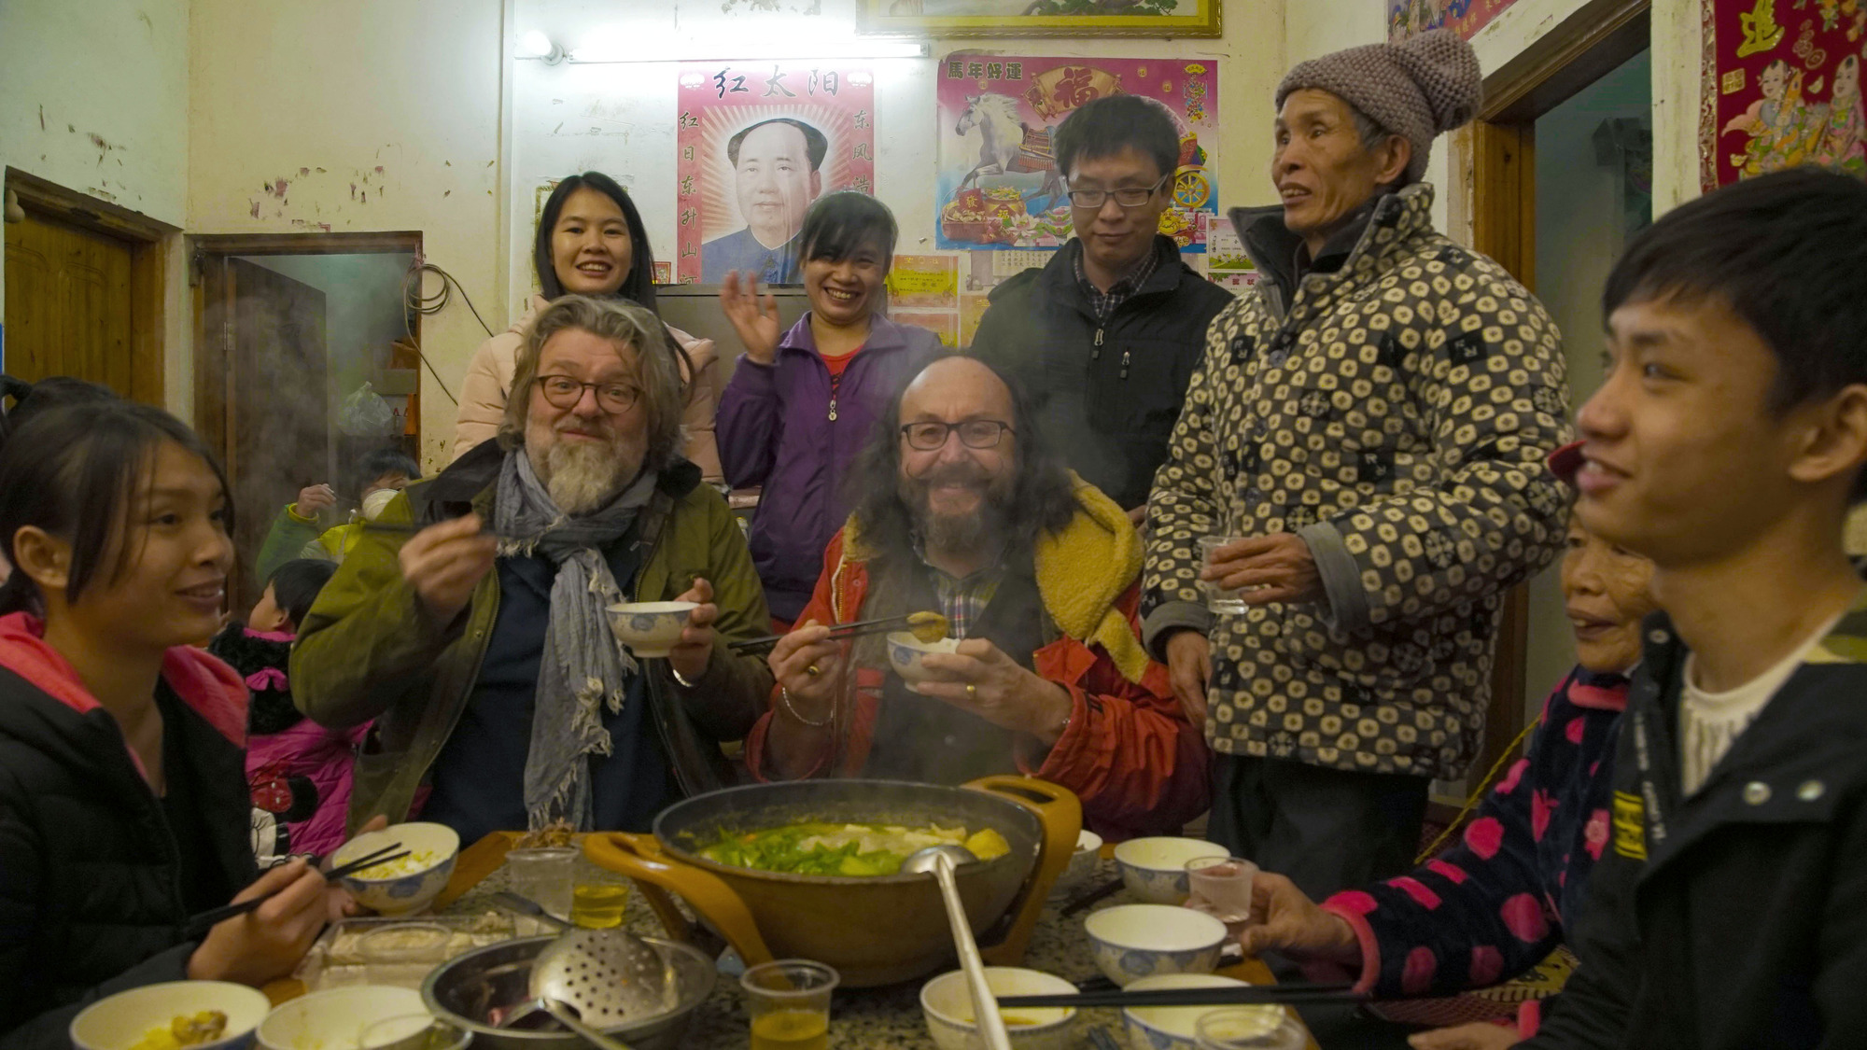
Chinese New Year: The Biggest Celebration on Earth

Slide 8
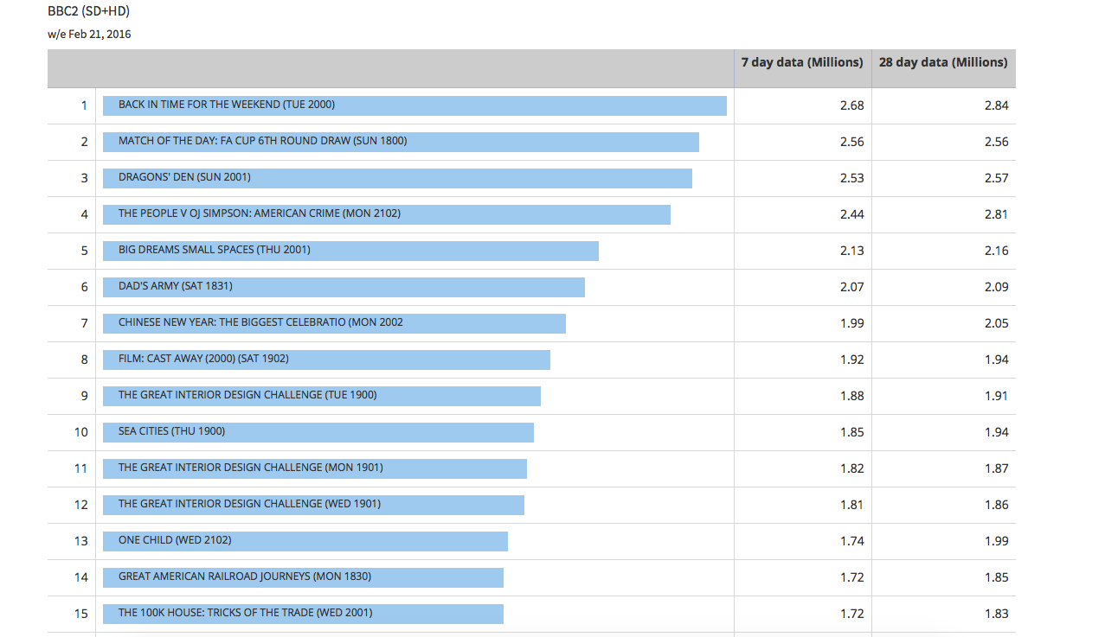
Chinese New Year: BARB Data TX Feb 2016
(TX14-16th Feb 2016)
UK BARB Data:15 Feb – 21 Feb, 2016

Slide 9
Planet Earth II

Slide 10
II. Sino-UK Format Trade
24h in A&E (Channel 4, 2011- ) (STV, 2014-15)
Who do you think you are? (BBC, 2004-) (CCTV, 2015-16)
Dancing on Ice (ITV, 2006-2014) (BTV, 2017)

Slide 11
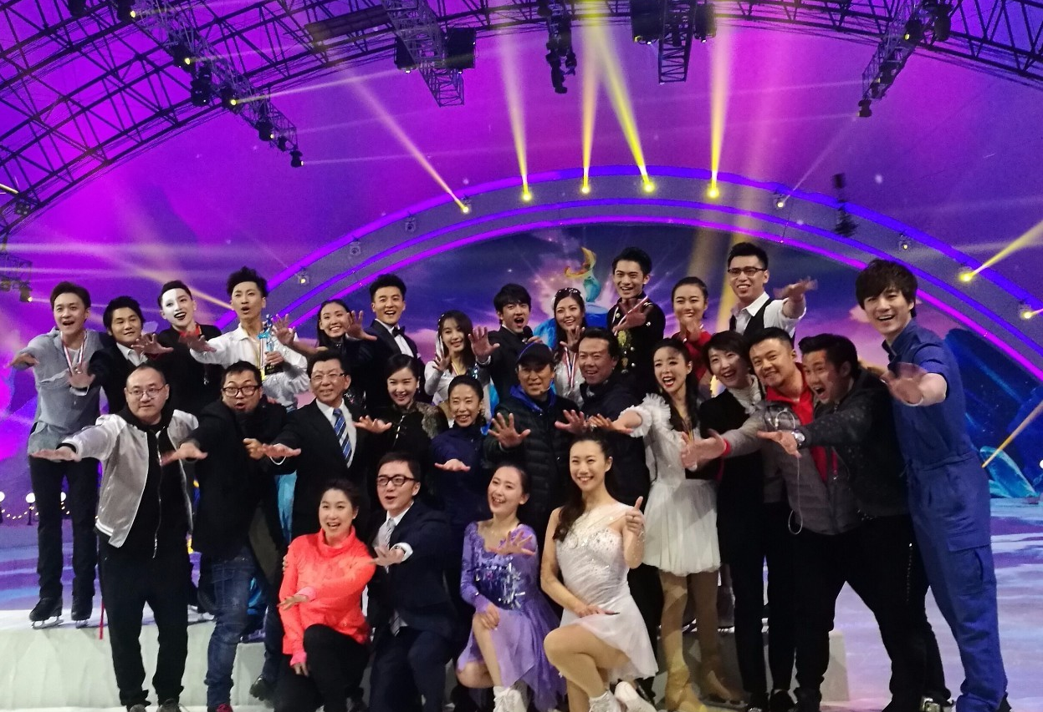
Case Study: Dancing on Ice

Slide 12
Dancing on Ice: UK

Slide 13
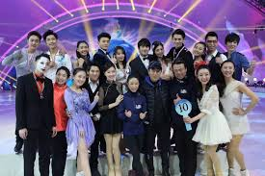
Dancing on Ice: China

Slide 14
II. Sino-UK Format Trade
Format is a two-way street: ‘Glocalisation’.
Global formats are being adapted with local cultures and talents.

Slide 15
III. Staff Visit and Exchanges
Senior staff and media executives visit the UK’s leading production companies and broadcasters.
Supported by the Prosperity Fund in China, in Feb 2017, ten executives from CCTV visited the UK independent production sector in London, Bristol and Brighton.
Universities like Westminster have launched China Media Research Centre hosting summer trainings for Chinese media professionals every year.

Slide 16
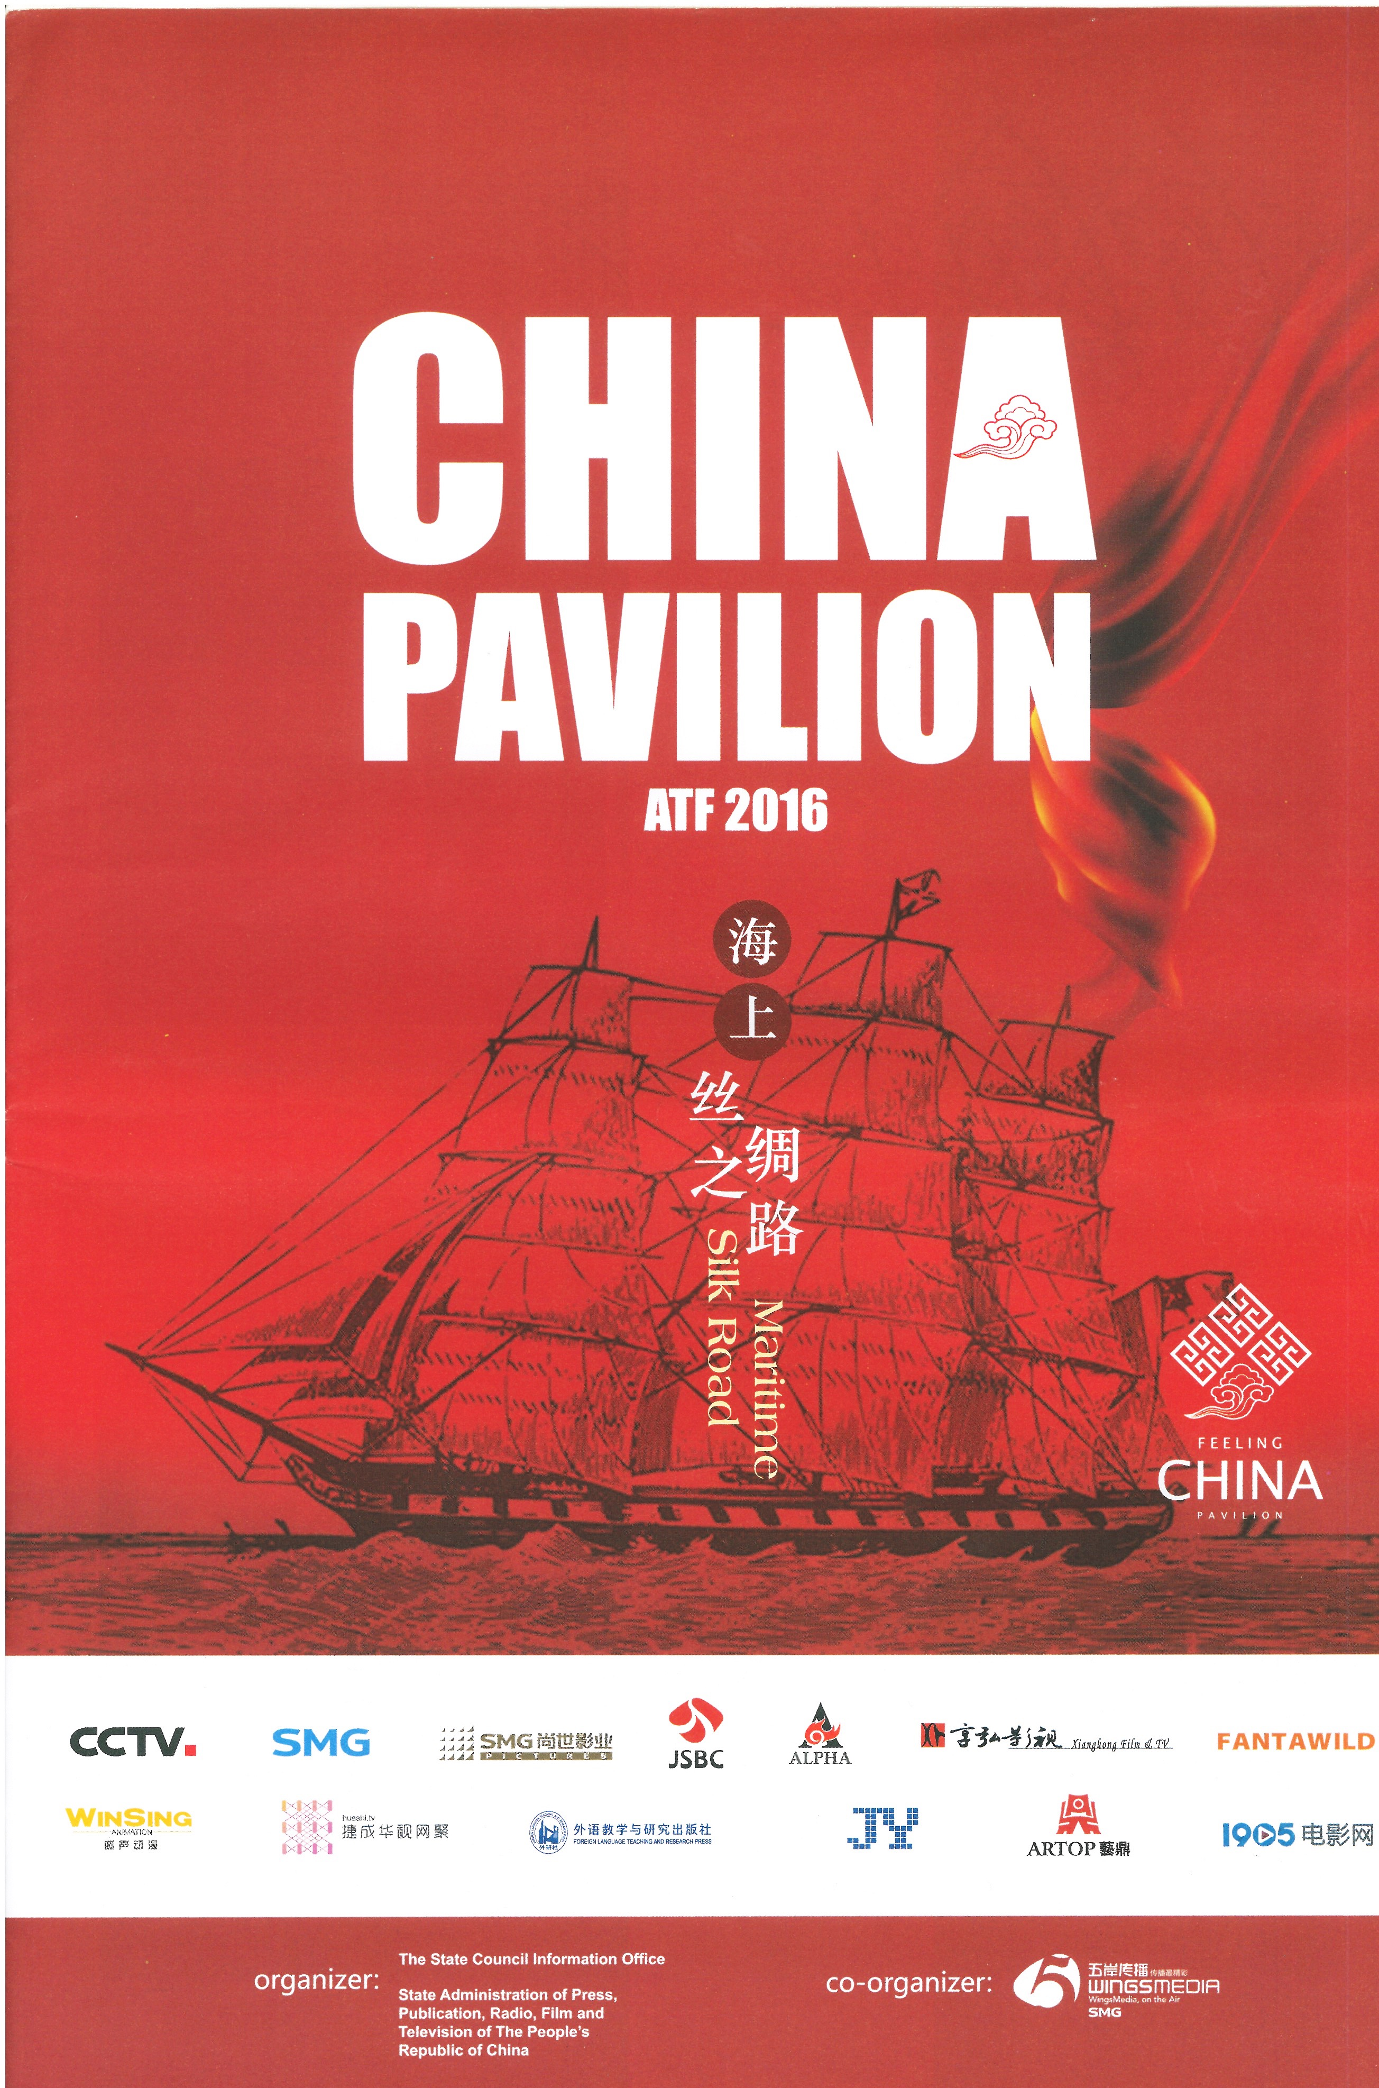
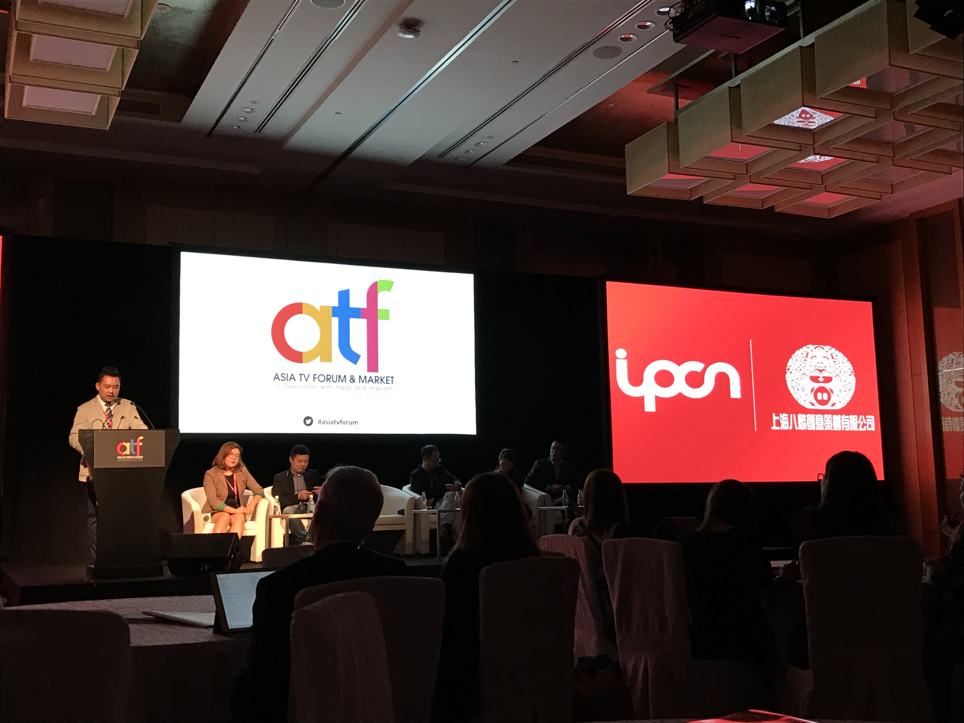
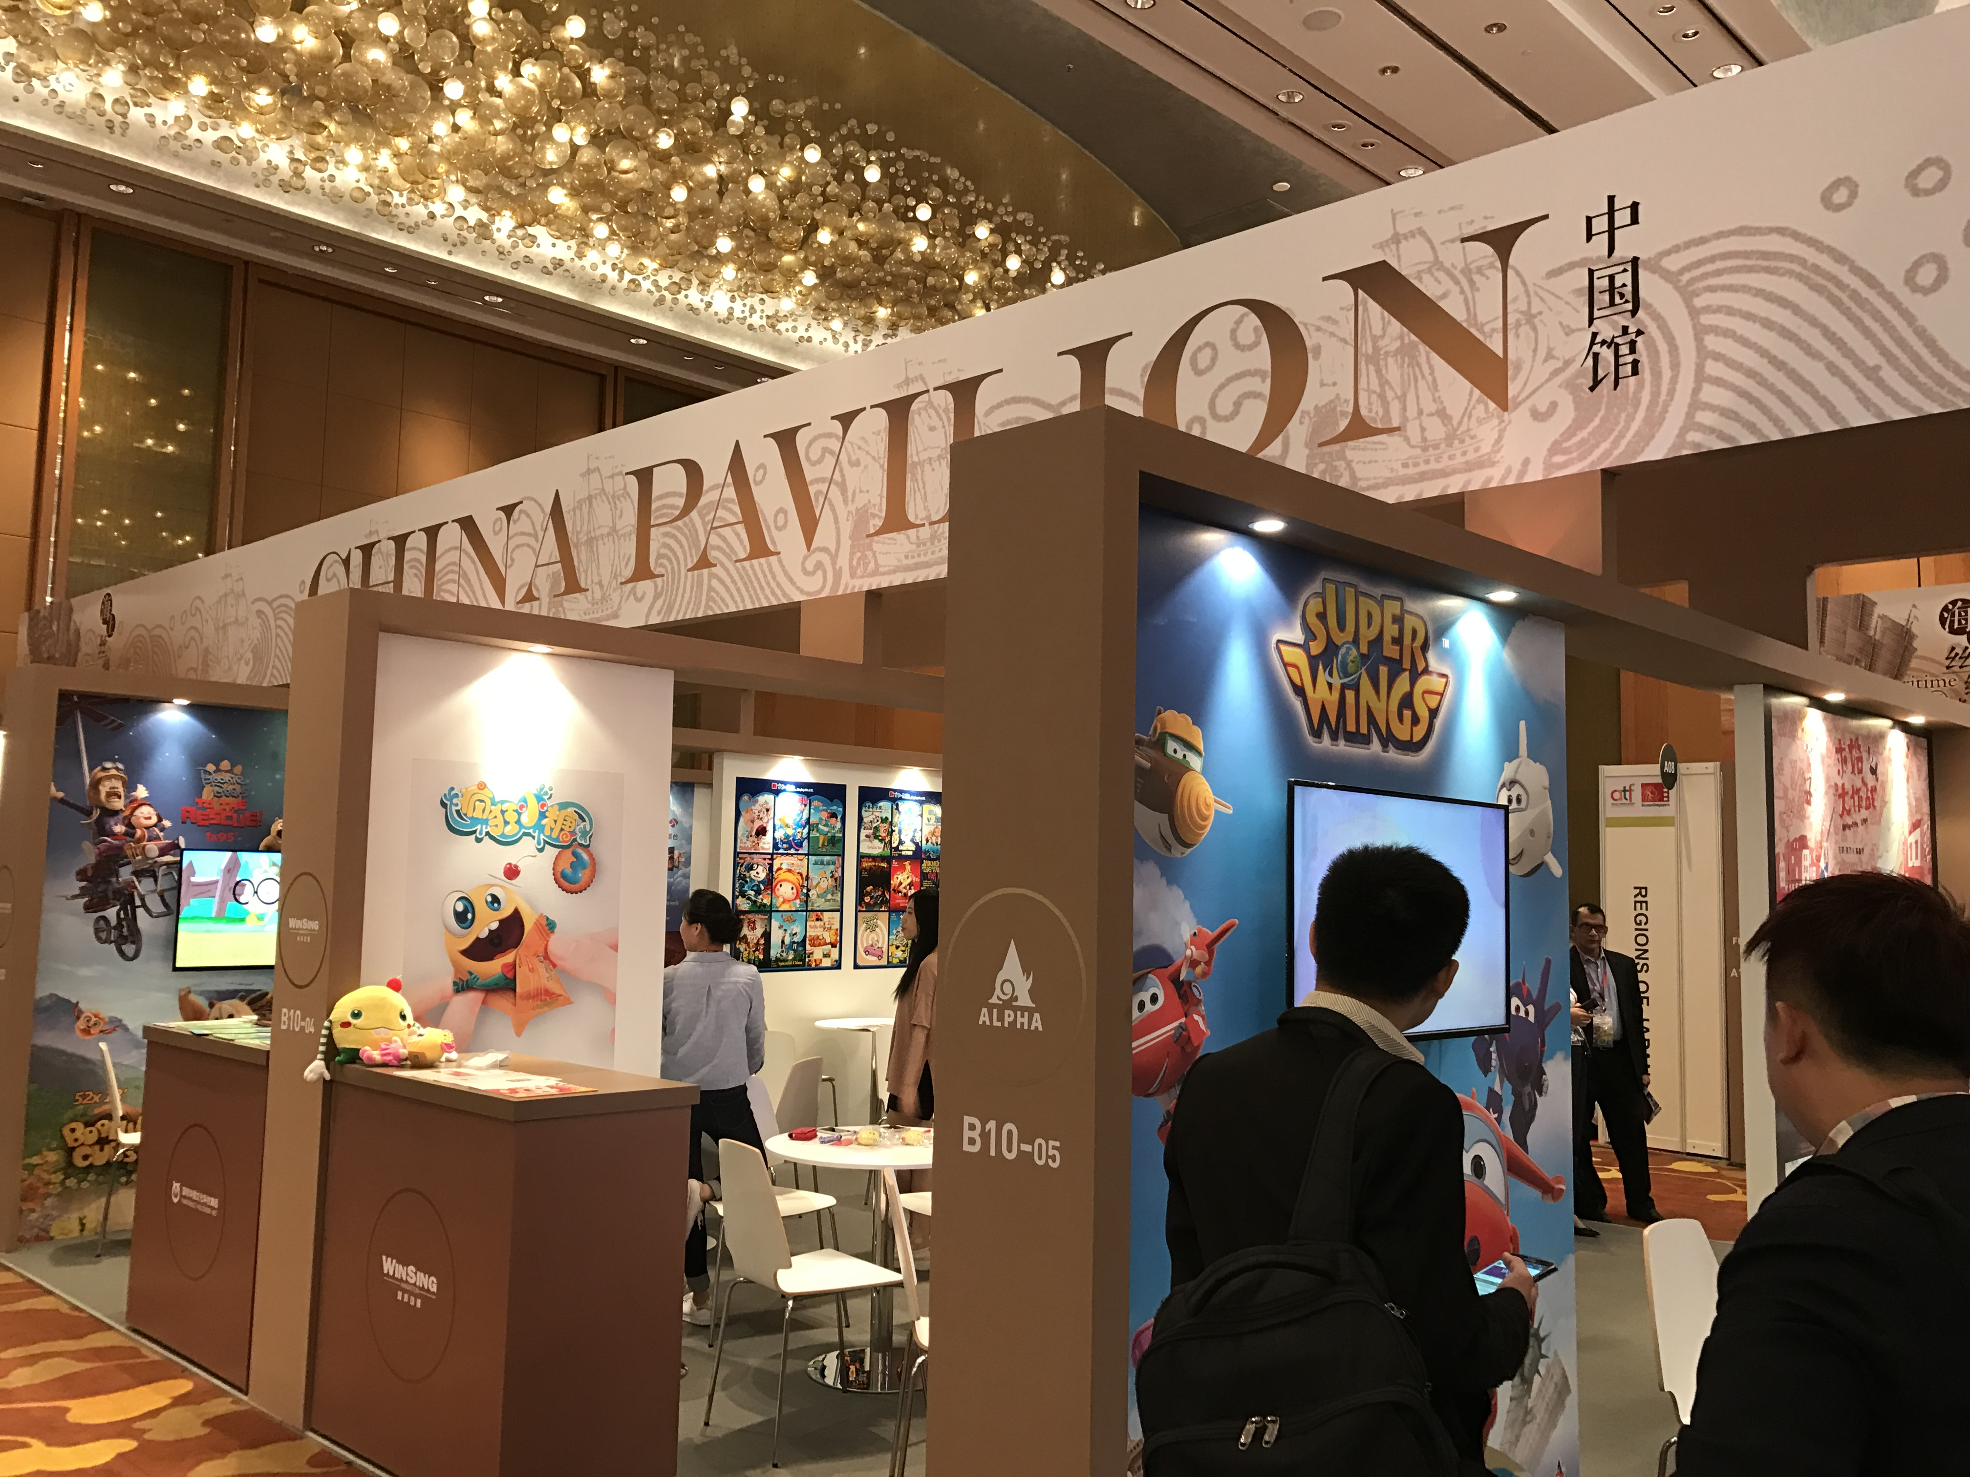
Silk Road at ATF 2016

Slide 17
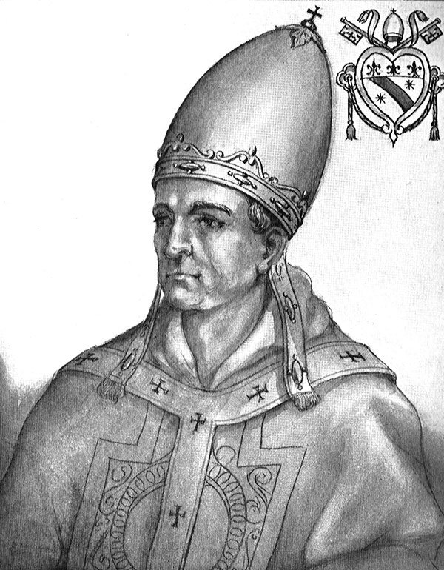
Rabban Bar Sauma (1220–1294)

