Slide 1
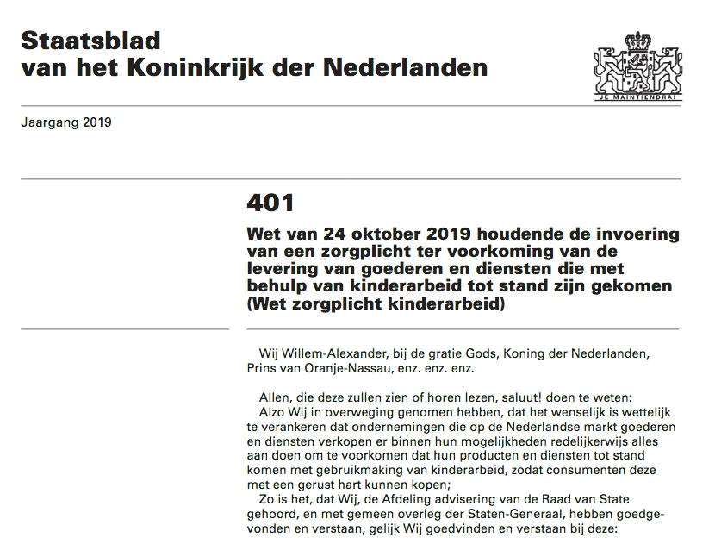
The Dutch Child Labour Due Diligence Law
Key elements, comparative perspective, limitations and critiques
Anneloes Hoff
DPhil Candidate in Socio-Legal Studies
University of Oxford
4 March 2020

Slide 2
Key elements
Duty to conduct due diligence / duty of care: declaration, investigation, action plan (requirements tbd)
Complaints mechanism
Appointment of supervisory authority (tbd)
Administrative sanctions and criminalisation of repetition

Slide 3
The legal duty
Duty for companies to investigate whether a reasonable suspicion exists that its goods or services have been produced using child labour, and, if so, to develop and implement an action plan to address this
Declaration
Once-off, when being recording in the commercial register (art. 4.2)
Published in public register by supervisory authority (art. 4.5)
Investigation
Draw on source the company can ‘reasonably be expected to know about and consult’ (art. 5.2)
Further requirements to be determined in general administrative order (art. 5.3)
Action plan
Further requirements to be determined in general administrative order (art. 5.3)

Slide 4
Definition of due diligence
Acting with due diligence = conducting an investigation into child labour and, if found, addressing it through an action plan
Duty of care / due diligence used interchangeably
Zorgplicht (only in title of law): literally ‘duty of care’, but refers to duty to act with due diligence
Gepaste zorgvuldigheid (in text of law): due diligence
Distinct from common law duty of care: generic duty to exercise care, not a specific duty owed to specific people

Slide 5
Access to remedy: complaints mechanism
Possibility for affected people to lodge a complaint based on concrete indications of non-compliance with provisions of the Law (art. 3.3)
First to be lodged with company (art. 3.4)
Possibility to escalate to the supervisory authority after 6 months (art. 3.2, 3.4)

Slide 6
Supervisory authority [toezichthouder]
TBD (general administrative order)
Candidates:
Netherlands Authority for Consumers and Markets (ACM)
In charge of enforcement of consumer protection laws
Indicated it lacks expertise
Possible role for NCP and SER (Social and Economic Council, economic advisory body to government and Parliament in charge of CSR covenants)

Slide 7
Sanctions – administrative
Administrative
Prior to administrative sanctions, supervisory authority can give a binding instruction [bindende aanwijzing] (an order to perform certain acts) to the company with with a timeframe for execution (art. 7.4)
Basis: Dutch General Adminstrative Law Act 5:2 para 2
Failure to produce a declaration: administrative fine €4,350 (art. 7.1)
Basis: Dutch Criminal Code art. 23.4 second category
Note: values for 2020. Value of fine is associated with category established in Criminal Code (will slightly increase every year)
Failure to conduct or inadequacy of investigation / action plan: administrative fine €870,000 or maximum of 10% of annual turnover (art. 7.2, 7.3)
Basis: Dutch Criminal Code art. 23.4 sixth category + art. 23.7 (on legal persons)

Slide 8
Sanctions – criminal
Criminalisation of repetition: directors as repeat offenders
Amendment to the Dutch Economic Offences Act
Violation of Child Labour DD Law is criminal offence if within 5 years of imposition of administrative fine a similar violation is committed ‘committed on the instructions of or under the de facto control of the same director’ (art. 9)
With intent (crime [misdrijf]): up to 2 years’ imprisonment, community service or €21,750 fine
Without intent (misdemeanour [overtreding]): up to 6 months’ imprisonment, imprisonment, community service or €21,750 fine
Economic Offences Act arts. 2.1, 6.1
Criminal Code art. 23.4 fourth category

Slide 9
Which companies?
All companies that provide goods or services to Dutch consumers (‘end-users’)
Exemptions TBD (general administrative order)

Slide 10
Comparative perspective
More limited scope: only child labour (but CSO desire to expand)
Wider application: not nationality of company, but nationality of end-users as point of departure
Harder sanctions
Potential criminal liability of directors (repeat offenders)
First to mandate the appointment of a supervisory authority
No specific requirements (although expectation is that the general administrative orders will provide more specificity)
Declaration is once-off (unlike annual statements under UK MSA)
Suggested role for voluntary initiatives (CSR covenants indirectly alluded to)

Slide 11
Voluntary guidelines vs binding obligations
Dutch NAP (2013): focus on sector-specific CSR covenants between companies, government, trade unions, NGOs
Dutch governance culture (‘polder model’)
Covenants address wide scope of social and environmental issues, include due diligence, but are not legally binding and cannot be enforced
Child Labour Due Diligence Law art. 5.4:
“Our Minister may approve a joint action plan intended to ensure that the enterprises that sign up to It act with due diligence to prevent goods or services from being produced with the aid of child labour, concluded between one or more civil society organisations and workers’ or employers’ organisations. An enterprise that acts in accordance with a joint action plan approved by Our Minister acts with due diligence”

Slide 12
Limitations and critiques
A lot left to be defined in general administrative orders
Particularly the supervisory authority
Ample room for business lobby
Relative vagueness
What is a ‘reasonable suspicion’?
Declaration is once-off, not in line with continuous nature of HRDD process according to UNGPs
Risk of tick box compliance
Framing as consumer protection rather than protection of potential victims of child labour
Preference for EU wide approach

